Slide 1
Creating Corporate Portal Sites
Introduction to Shared Service Providers
and the Corporate Portal site template

Slide 2
Agenda
History: SharePoint Portal Server 2003
The Corporate Portal Site Template
Managing Content
Shared Service Provider Architecture

Slide 3
SharePoint Portal Server 2003 (SPS)
SharePoint Portal Server 2003 Features
Areas and listings
User profiles and audience targeting
Search
My Sites
Shared Services
Single sign on
Notes:
Instructor Notes
Start the lecture by asking which students have experience with SPS 2003. Ask any students that have used SPS 2003 which features were particularly valuable to their company.
Step through the SPS 2003 feature set in the top set of bullets and take 2-3 sentences to describe the purpose of each feature for students that do not have SPS 2003 experience.
Finally, walk through the second set of bullet points and discuss customer complaints about SPS. Emphasize the problems with CMS integration. Ask students if any them have experience with CMS or the integration layer between SPS 2003 and CMS named SPARK.

Slide 4
Problems with SPS 2003
Problems with SharePoint Portal Server 2003
A strange semi-undocumented layer on top of WSS V2
Limited to one SPS portal site per IIS Web application
Portal user interface hard to customize and extend
Shared Services architecture hard to deploy and administrate
Limited and clunky integration with Content Management Server
Notes:
Instructor Notes
Start the lecture by asking which students have experience with SPS 2003. Ask any students that have used SPS 2003 which features were particularly valuable to their company.
Step through the SPS 2003 feature set in the top set of bullets and take 2-3 sentences to describe the purpose of each feature for students that do not have SPS 2003 experience.
Finally, walk through the second set of bullet points and discuss customer complaints about SPS. Emphasize the problems with CMS integration. Ask students if any them have experience with CMS or the integration layer between SPS 2003 and CMS named SPARK.

Slide 5
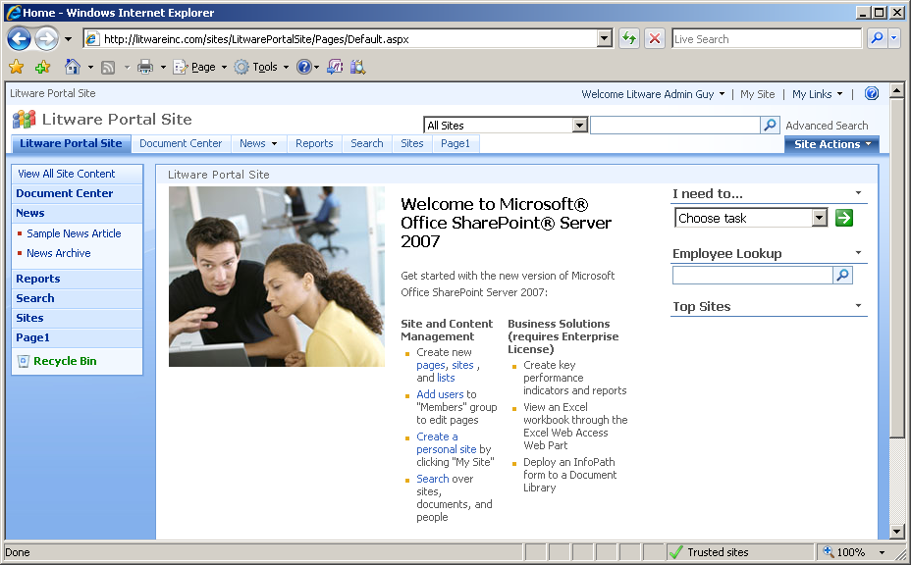
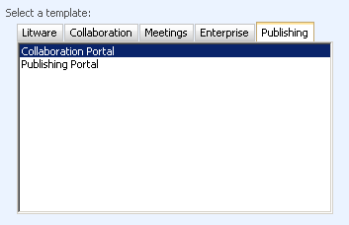
Collaboration Portal Site Template
Used to create SPS-like Portal sites
Supplies same basic features as SPS
Except that Areas and Listing have been eliminated

Slide 6
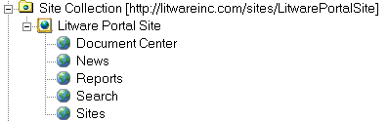
Collaboration Portal Architecture
A collaboration portal is a hierarchy of WSS sites
Created as a WSS site collection
Created using standard Site Definitions and Features
Architectural improvements over SPS portals
Not limited to one portal per IIS Web site
Portals extended using standard WSS V3 development
Notes:
Instructor Notes
The portal architecture of MOSS is very different than SPS 2003 because portals are now created using standard WSS site templates. That means you create a new portal as a new site collection using the WSS Central Administration application.
There are several site templates used to create portals in MOSS
Corporate Portal
Blank Portal
Publishing Site
Portal for Internet presence
Note that the site templates for portals define child sites. That means you will be creating a new site collection with several sites each time you create a new portal. And because a portal is simply seen as another WSS site collection, you can create 100s or 1000s of portals per Web application.

Slide 7
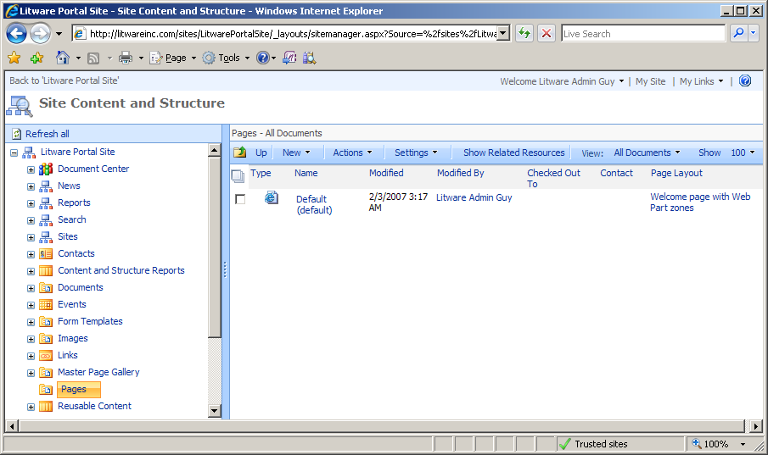
Site Content and Structure
Notes:
Instructor Notes
This page is a very important one. You can point to many features here:
seeing the content in the different lists and libraries
seenig the resources used by an item in these lists and libraries
seeing the sub-sites
being able to move sites in the hierarchy
Do not cover yet the concept of the master page gallery and the pages library.

Slide 8
Sharing Resources and Services
Need to share resources/services across sites
Content crawling and index creation
Querying for search results
Allocating and managing storage for My Sites
SPS used 1st generation shared services model
One portal site is selected as "Master" portal
Other portals use shared services of master portal
MOSS takes a different and better approach
Enter the Shared Service Provider (SSP)
Notes:
Instructor Notes
Shared Service Providers (SSPs) are an important architectural piece of MOSS so you should take some time to motivate them properly. Start by motivating that there are important tasks in the portal (e.g. building indexes for search and provisioning MySites) that should not be done two or more times when unnecessary. It makes sense to have a central entity that can do this work a single time across multiple portal sites.
Quickly explain that SPS 2003 used an approach where one portal was deemed as the master to do the work to be shared across portals. Other portals were configured as slaves so that they could use the indexes and MySite provisioning of the master. However, this architecture was not flexible and it was very fragile when it cam to backup and restore. The new architecture is much better because an SSP is defined and configured independently of any portal site.

Slide 9
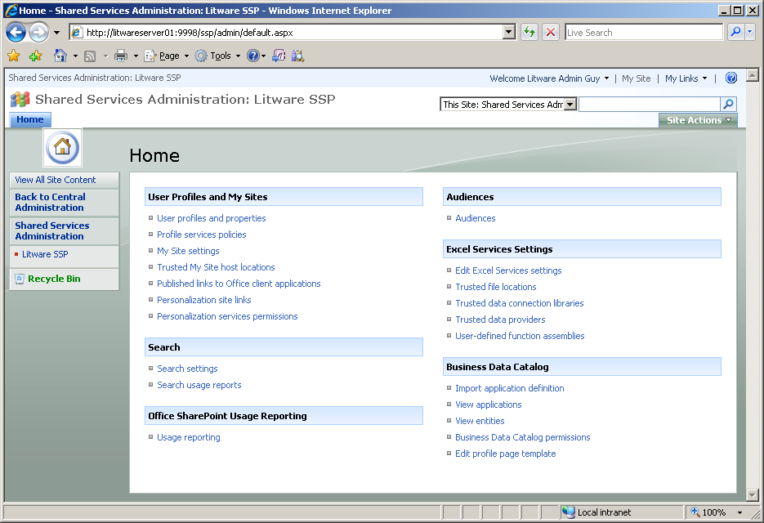
SSP Administration
Functionality of SSP Broken out into Sections
MOSS
Enterprise
Edition Only
Notes:
Instructor Notes
This is the main configuration page for an SSP. You can use this slide to explain which new MOSS services are configured through SSPs. In SPS 2003, the Shared Services infrastructure involved user profiles indexing, search and my sites. The new SSP architecture has all the same things and has been expanded with Excel Services and the Business Data Catalog as well.

Slide 10



So what is a Portal, Really?
A Site Collection that…
has the correct features activated
is consuming services from an underlying SSP
might or might not have been created from a portal site template
SharePoint Server
Web Application(s)
Portal Template
SSP Admin
Central Admin
Portal Template

Slide 11
Collaboration Portal
Collaboration Portals are
For Sharing Information
Expanded through Business Users/End Users adding and editing content
SharePoint features to use to make it easier for your content creators:
Create reusable templates
Consistent navigation

Slide 12
Save Site as Template
Custom Site Templates can be created and reused
Site can be saved with or with out content
The following items will be included with the template:
Theme
Web Parts
Lists/Libraries

Slide 13
Save List as Template
Helpful when same list structure is going to be used on multiple sites.
List can be saved with or without content
Template will include:
Views
Columns
Settings

Slide 14
Navigation
Like security navigation is inherited
Links may be added or removed
The main elements are:
Quick Launch Bar (Current Navigation)
Top Link Bar (Global Navigation)
Breadcrumb

Slide 15
Summary
History: SharePoint Portal Server 2003
The Corporate Portal Site Template
Managing Content
Shared Service Provider Architecture

